Slide 1
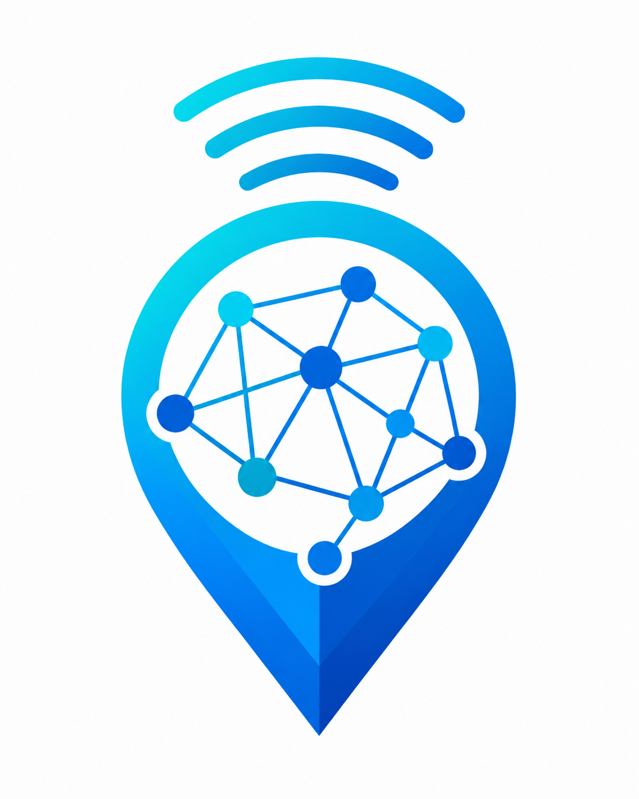
Design and Implementation of a Crowdsensed Drive Test Mobile Application
for Coverage Prediction
Your phone. Your network. Your map.
CrowdSenseNet
Group 13 • CEF 440: Internet Programming and Mobile Programming
Faculty of Engineering and Technology • University of Buea

Slide 2



The Problem
Measuring real-world network coverage is expensive and incomplete
Traditional drive testing
Engineers drive routes with specialised equipment to record signal quality — accurate, but limited to main roads.
Expensive & hard to scale
Specialised vehicles and equipment make wide, frequent coverage testing costly, especially in developing regions.
Misses where problems are worst
Indoors, in rural communities, and off the main road network — exactly where users report the weakest signal.
CrowdSenseNet | Group 13 | CEF 440
2

Slide 3



Our Solution
Turn ordinary Android smartphones into a crowdsensing network
Instead of relying on a few expensive drive-test vehicles, CrowdSenseNet passively collects real cellular network measurements from everyday smartphones as people go about their normal lives — turning every phone into a lightweight, low-power measurement device.
→
→
Many Smartphone Users
Backend Aggregation
Coverage Map
Everyday users passively contribute signal readings as they move through different locations.
Readings are validated, anonymised, and combined into a single geospatial dataset.
Aggregated data reveals real coverage patterns — including hidden dead zones.
CrowdSenseNet | Group 13 | CEF 440
3

Slide 4






What Every Phone Measures
Six data elements captured through the device's built-in APIs
RSRP
RSRQ
SINR
Reference signal received power
Reference signal received quality
Signal-to-interference-plus-noise ratio
RSSI
GPS Coordinates
Cell ID & Timestamp
Received signal strength indicator
Location tagged to every reading
Serving cell and exact collection time
Every reading is anonymised on-device before it ever leaves the phone — no names, no phone numbers, no IMEI.
CrowdSenseNet | Group 13 | CEF 440
4

Slide 5


System Architecture
Three tiers working together, end to end
Android App
Backend Server
Admin Dashboard
Data Collection
→
Validation & Storage
→
Visualisation & Action
Kotlin + Jetpack Compose (MVVM)
Reads TelephonyManager & GPS
Offline-first Room database
Node.js / Express REST API
PostgreSQL + PostGIS
Coverage zone classification
Live map & heatmap
Session explorer & reports
CSV / GeoJSON export
All communication between the device and backend uses HTTPS with TLS 1.2 or higher.
CrowdSenseNet | Group 13 | CEF 440
5

Slide 6


Built for Real-World Connectivity
Signal readings are never lost, even without internet access
No Connection
Connectivity Restored
→
Measurements are stored securely on the device in a local Room (SQLite) database. Collection, viewing, and history all keep working offline.
Once WiFi becomes available, buffered readings are automatically batched and uploaded over an authenticated HTTPS connection.
< 5%
3 taps
100%
Battery drain per hour
To start or stop collection
Anonymous — no login required
CrowdSenseNet | Group 13 | CEF 440
6

Slide 7


Turning Signals Into Action
Network engineers see coverage holes and export data for real decisions
Live Data Feed
Coverage Map
New uploads appear on the dashboard within seconds via a real-time WebSocket channel.
Session & Reading Explorer
Filter and search historical readings by date, operator, region, or coverage class.
Reports & Export
Generate coverage reports and export CSV / GeoJSON datasets for tools like QGIS.
Privacy by Design
No reading can ever be traced back to a name, phone number, or device owner.
Good (> -80 dBm)
Average (-80 to -100 dBm)
Coverage hole (< -110 dBm)
Insufficient data
CrowdSenseNet | Group 13 | CEF 440
7

Slide 8





Our Development Journey
A complete mobile application development lifecycle
1
2
3
4
5
6
Requirements
System Design
UI Design
Implementation
Database
Testing
Interviews, 102-user survey, brainstorming
UML diagrams, MVVM architecture
Figma screens, brand identity
Kotlin app, Node.js backend
PostgreSQL + PostGIS schema
API, database, integration tests
Every design decision traces back to real evidence — stakeholder interviews, a 102-respondent survey, and hands-on analysis of existing apps.
CrowdSenseNet | Group 13 | CEF 440
8

Slide 9

A Scalable, Low-Cost Alternative
to Traditional Drive Testing
Crowdsourced data from many everyday users, not a handful of vehicles
Privacy-first: fully anonymised, no login, no personal data collected
Adaptive, battery-efficient background sensing users can trust
Real-time dashboard turning raw signals into actionable coverage insight
Thank you.
We will now demonstrate how CrowdSenseNet works.

Slide 10
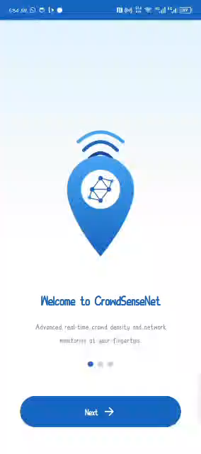
Live Demo
CrowdSenseNet | Group 13 | CEF 440
10
Notes:
Insert the CrowdSenseNet screen-recording / demo video in place of this placeholder before presenting. Walk through: opening the app, granting permissions, starting a sensing session, viewing live signal metrics, then switching to the admin dashboard to show the reading appear on the live feed and coverage map.

